Slide 1


Transitioning a Clinical Trial to a Registry Using Digital Technology

Slide 2
Clopidogrel
CAD affects 7.6 million people in the U.S.
2.5 to 3 million clopidogrel prescriptions are written per month
Thienopyridine P2Y₁₂ADP receptor antagonist
FDA indications
  Myocardial infarction
  Thrombotic CVA
  Peripheral arterial disease
  Percutaneous coronary intervention

Slide 3
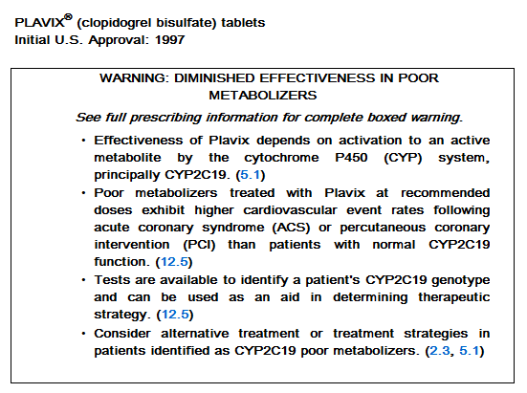
Clopidogrel: Black-box Warning
March 12, 2010

Slide 4
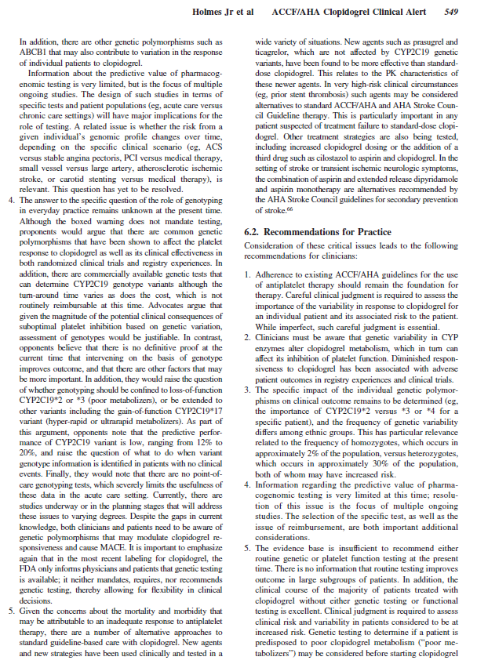
The evidence base is insufficient to recommend either routine genetic or platelet function testing at the present time. There is no information that routine testing improves outcome in large subgroups of patients.
Circulation
2010

Slide 5
TAILOR-PCI study design
Clinicaltrials.gov (NCT01742117)
Coronary Angiography / PCI
Referrals
Screen & Consent
No PCI
PCI
Screen Failures
Enrolled RANDOMIZED
Conventional
Arm
5,270 patients
Prospective
Genotyping Arm
Clopidogrel 75 mg daily
CYP2C19*2 & *3
WT CYP2C19
1-year follow-up
12 month/Retrospective genotyping
Ticagrelor
90 mg BID
Clopidogrel
75 mg daily
WT CYP2C19
CYP2C19*2 & *3
Primary outcomes: non-fatal MI, non-fatal stroke, CV death, urgent revascularization, stent thrombosis (if not captured above)

Slide 6
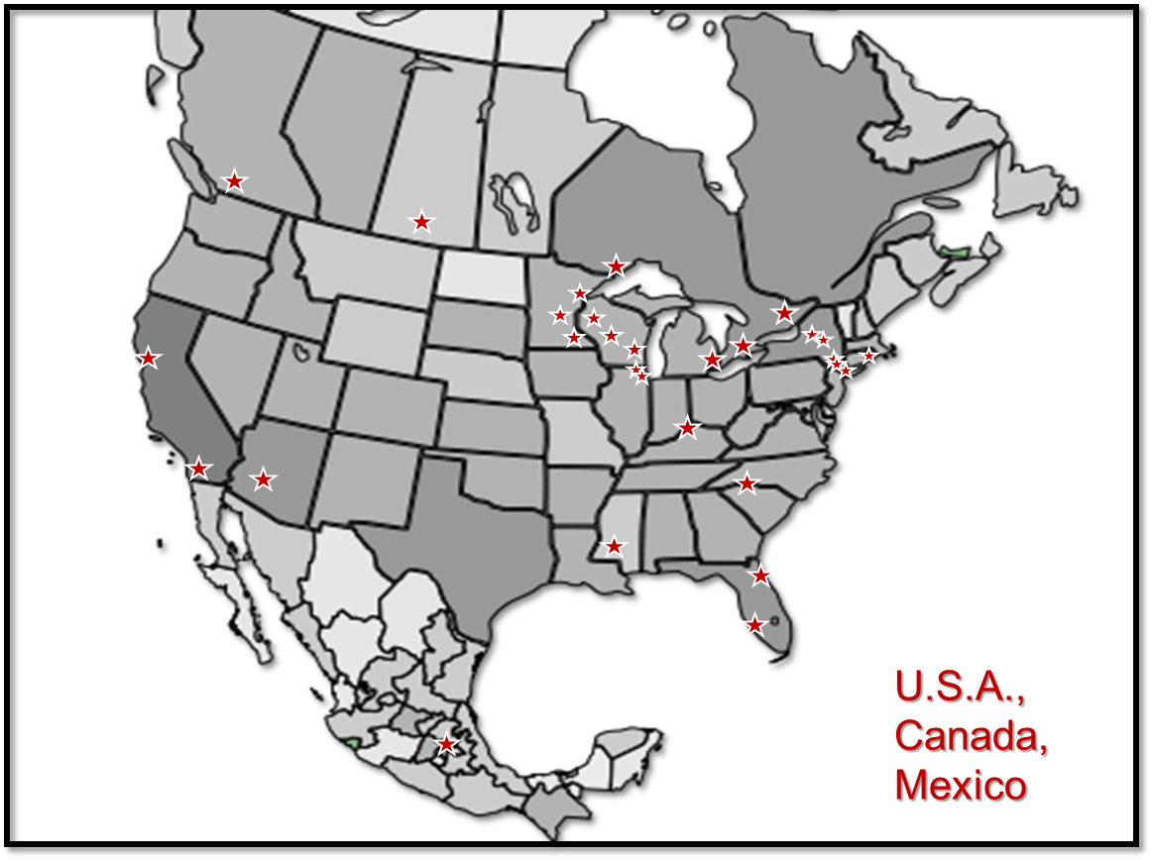
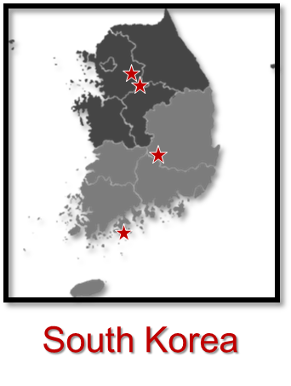
TAILOR-PCI STUDY SITES

Slide 7
Enrollment
Notes:
This is Figure 2 on page 12 of the Open Report.

Slide 8
TAILOR-PCI – Extended Follow-up
High impact on a highly prevalent disease
Rich phenotypic data
Extensive biobank for studies like GWAS
Extended FU
  Cost-effective
  Operationally efficient

Slide 9
Digital Follow-Up
Aims:
  To extend long-term follow-up using digital technology, the Eureka Mobile Research Platform, among participants of the randomized clinical trial, TAILOR-PCI, in order to follow them beyond the current 1 year post PCI period.
    We hypothesize that patients enrolled in a randomized clinical trial can be subsequently successfully recruited for a registry using digital technology.

Slide 10
Digital Follow-Up
Aims:
  (a) To assess in TAILOR-PCI subjects the prescription patterns of DAPT beyond 1 year post PCI and in a subset of subjects, use a validated smartphone-based geo-fenced tracking application to detect hospitalizations.
    We hypothesize that detection of hospitalizations using smartphone geo-fencing technology will be non-inferior to study coordinator follow-up telephone calls.

Slide 11
Digital Follow-Up
Aims:
  (Exploratory) To track digital markers (heart rate, activity, and 6 minute walk test distance) in patients enrolled in the TAILOR-PCI registry in an attempt to discover predictors of MACE or major bleeding events following PCI by novel digital techniques.

Slide 12
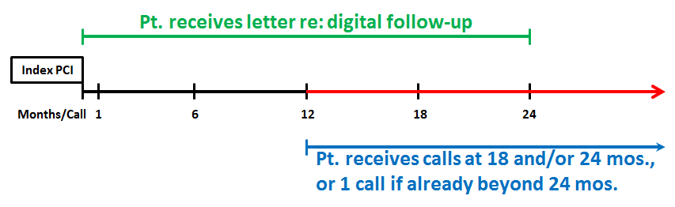
Extended & Digital Follow-Up
(Est. 1192 pts.)

Slide 13
Digital Follow-Up: Overview
Only U.S. & Canadian participants are eligible
Site only assists with notification of current TAILOR-PCI participants
  Mayo coordinates & administers digital follow-up sub-study
TAILOR-PCI participants within 24 mos. of PCI will be asked to download the TAILOR-PCI Eureka mobile app
  All participant surveys and activities done through smartphone
  Est. 1192 eligible participants from U.S. & Canadian sites

Slide 14
Digital Follow-Up
Step 1: Inviting Participants and Web Onboarding
[MAYO]
Mayo generates spreadsheet with TAILOR-PCI IDs & Index Procedure Date
[UCSF]
UCSF adds matching Unique Participant Code, patient specific URL, and columns for patient name & address to be used in patient contact letter, using mail merge
[MAYO]
Mayo send s site-specific spreadsheets to sites
[SITES]
Sites populate the blank columns with patient name & address
[SITES]
Sites generate letters for patients and mail letters
[SITES]
If no consent from letter, sites invite patients by phone again (max. 2 attempts)
Website explaining study
Patient enters Unique Participant Code as validation
Login
Eureka Account Creation

Slide 15
Digital Follow-Up
Step 1: Inviting Participants and Web Onboarding (cont.)
(Optional)
Human API medical record connection
User downloads Eureka mobile app
Verify phone number
Text message sent to download Eureka app
Assessment
Eligibility Criteria:
Willing to download app to participate in study?
Consent
Unique consent form where user clicks on “I Agree” to allow digital monitoring tools
Authorization
HIPAA Auth. Form
Medical Document Release Form
Eureka texts confirmation code to user
User inputs text confirmation code

Slide 16
Digital Follow-Up
Step 2: Eureka App Sign In and Baseline Activities
(iOS only)
Background location service access
Sign in to Eureka Mobile App
(Optional)
Permission to access
HealthKit (iOS) or GoogleFit (Android)
(Optional)
Push notification access
(Optional)
Location service access
Baseline Visit
Dyspnea Scale
Hospitalization Survey
Medications
Seattle Angina Ques. (SAQ)
Duke Act. Score Ind. (DASI)
General Anxiety Disorder-7
Angina Diary
Baseline Visit
6 Minute Walk Test +
Borg scale after +
Heart rate- before/after

Slide 17
Digital Follow-Up
Step 3: Weekly and Monthly Study Activities
Weekly 30 second heart rate
Weekly angina diary
Monthly visits from date of index procedure up to 24 months
Dyspnea Scale
Hospitalization Survey
Medications
Seattle Angina Ques. (SAQ)
Duke Act. Score Ind. (DASI)
6 Minute Walk Test +
Borg scale after +
Heart rate before/after
Study finish 24 months after index PCI
Every 6 months from digital consent follow-up
General Anxiety Disorder-7
If GPS detects user in hospital for extended time
Hospitalization Survey

Slide 18
Recruitment Letter

Slide 19
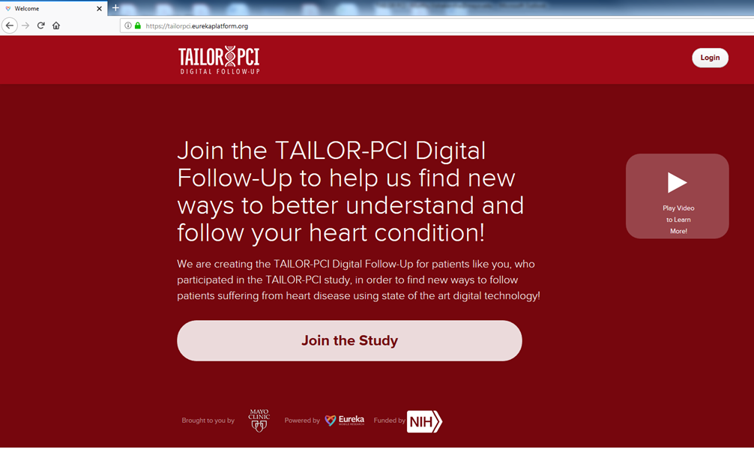
Landing Page

Slide 20
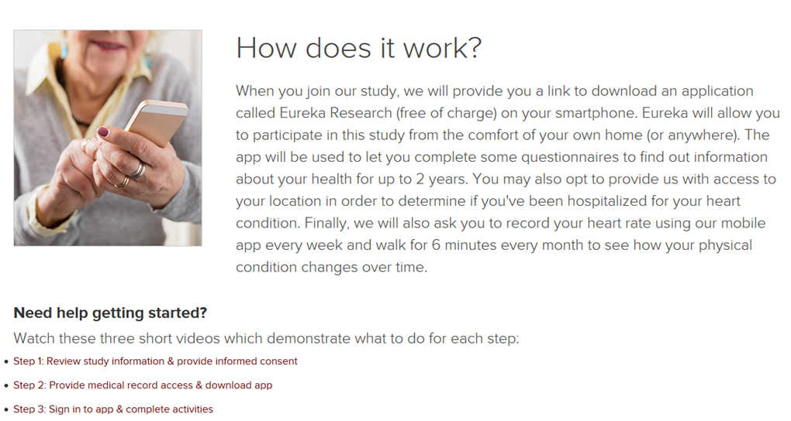
Instructional Videos

Slide 21
Staged Site Rollout
Mayo Clinic Sites
  February, 2019: Began mailing letters for digital sub-study
External Sites with IRB and contract approvals
  March, 2019: Began mailing letters for digital sub-study

Slide 22
IRB Challenges
Concerns from Mayo Clinic IRB
  Potential action needed due to depression survey (removed)
  Additional review by Research Info. Security Advisory Group
Concerns from external IRBs
  Verbal consent for extra calls not in original consent form
  New concept of digital sub-study administered by one IRB
  New way to consent with a non site-specific form on website
Additional concerns from Canadian REBs
  Can’t guarantee app meets all Canadian privacy laws
  PHI entered flows directly to U.S., under U.S.A. Freedom Act
  Canadian patients being directly recruited for a U.S. study

Slide 23
Mayo / External Site Challenges
IRB approval required from each site, not centralized
Contract addendum approval
Rely on sites to recruit for Mayo administered study

Slide 24
Participant Challenges
Participants have multiple contacts: site study coordinator(s) and new contact for digital questions
Participants limited by their available computer technology or their own computer literacy
  Some don’t own smartphones
  Some don’t know how to access internet
  Some don’t know how to download app
  Some still want to participate but can’t because of above
Participants receiving requests for longer time commitment and different kind of research participation than original consent

Slide 25
Lessons Learned
Incorporate consent for extended follow-up in initial consent form of study
Create contract addendums for external sites
Consider possibility that participants may not have a smartphone
Allow for computer based web only follow-up
Link to EHR may prove to be a logistic hurdle
Improve the transition from the website accessed from a desktop to the smartphone app

Slide 26
Acknowledgements
Funding Sources
NHLBI
PGRN
Mayo CV & CIM
TAILOR PCI team
Michael Farkouh
41 sites – PIs and SCs
Jeff Olgin and UCSF team
Kent Bailey & Ryan Lennon
NHLBI
  Yves Rosenberg
  Erin Iturriaga
  Ahmed Hasan
  Nancy Geller
  Yi-Ping Fu

Slide 27
Questions? pereira.naveen@mayo.edu
@nl_pereira

